Slide 1

The Samsara Framework Establishing Transnational
Pedagogical Practices and
Talking about it.
Dr Deirdre O’Toole and Damien Byrne

Slide 2
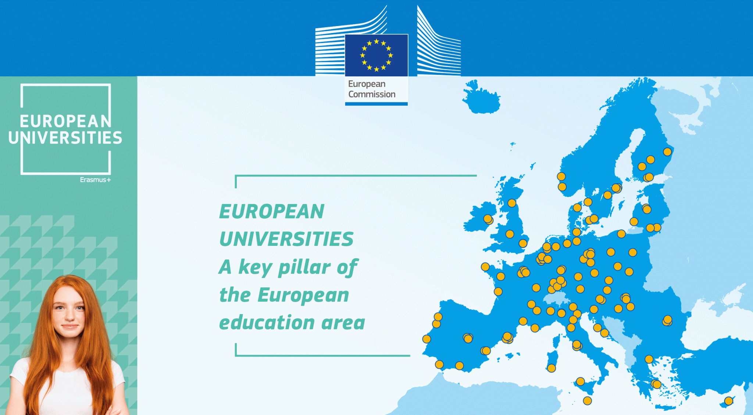




Who Are We?
Ref. 101004047, EPP-EUR-UNIV-2020 | Ref: 101035820, H2020-IBA-SwafS-Support-2-2020

Slide 3
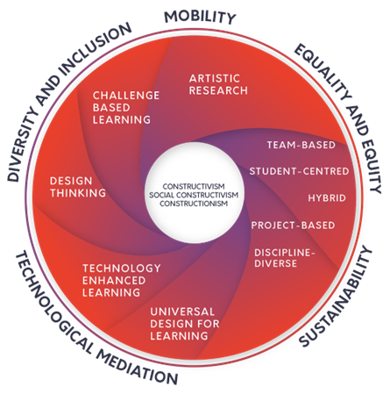

SAMSARA Pedagogical Framework
Samsara proposes that artistic teaching, learning, research, and production are practice-based, collaborative endeavours that engage ethically and actively with societal problems through the creative use and mediation of technology. At FilmEU, we believe that people learn best when they are making meaningful creative work together, on equal terms
Ref. 101004047, EPP-EUR-UNIV-2020 | Ref: 101035820, H2020-IBA-SwafS-Support-2-2020
Notes:
●Mobility,
Equality and Equity
Sustainability
Technological mediation
Diversity and Inclusion
The use of technology in film and media arts should be taken as both natural and fundamental to the creative process: technologies enable students to create work (via tools, equipment, mediums, media). ● Technology is integral to the experience of learning and teaching (via Virtual Learning Environment (VLE) and other technological platforms). These technologies must be fully functional and seamlessly integrated into the learning process. ● Technology plays a key mediating role in how students, teachers, and stakeholders collaborate and communicate with others to shape, complete, curate, and share their vision and creative works. ● The use of technology in film and media arts implicitly contains ethical and social components that must be viewed critically especially in the areas of policies, privacy, equity, and human health.

Slide 4
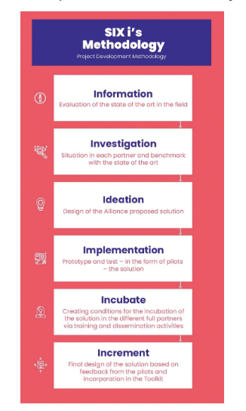
SIX i’s Methodology
As a FilmEU Research group we also took on the 6i Methodology which will be a familiar workflow for those of you who understand Design Thinking – Where each iteration of an idea involves research, investigation, implementation. Analysis and of course….REPEAT!
Ref. 101004047, EPP-EUR-UNIV-2020 | Ref: 101035820, H2020-IBA-SwafS-Support-2-2020

Slide 5
What is Challenge Based Learning?
Ref. 101004047, EPP-EUR-UNIV-2020 | Ref: 101035820, H2020-IBA-SwafS-Support-2-2020
Notes:
To empower students in the understanding of film and media history.
To give students comprehensive tools to discern and discuss the ethics of gender, sexual representation, classification and censorship at an international level.
The establishment of solid competences in digital film, providing students with key skills for contemporary film and media filmmaking.
To train students to work in a team-based environment.
Objectives:
The expansion and application of an interdisciplinary training program focusing on transmedia, providing students with the right theoretical and technical skills to succeed as transmedia creators.
To promote a comprehensive mapping of contemporary media outlets.
Students will learn how to discover and research differences and similarities between people with different cultural backgrounds, becoming proficient in understanding international projects.
Any group which, at the start, includes individuals with different levels theoretical and technical know-how should, at the end, express a more balanced level of proficiency.
The blossoming of co-production enterprises between all institutions involved in the FilmEU Alliance.
To create a solid platform for discussion and consolidation on the topic of citizenship and democracy when applied to an author’s social impact.

Slide 6
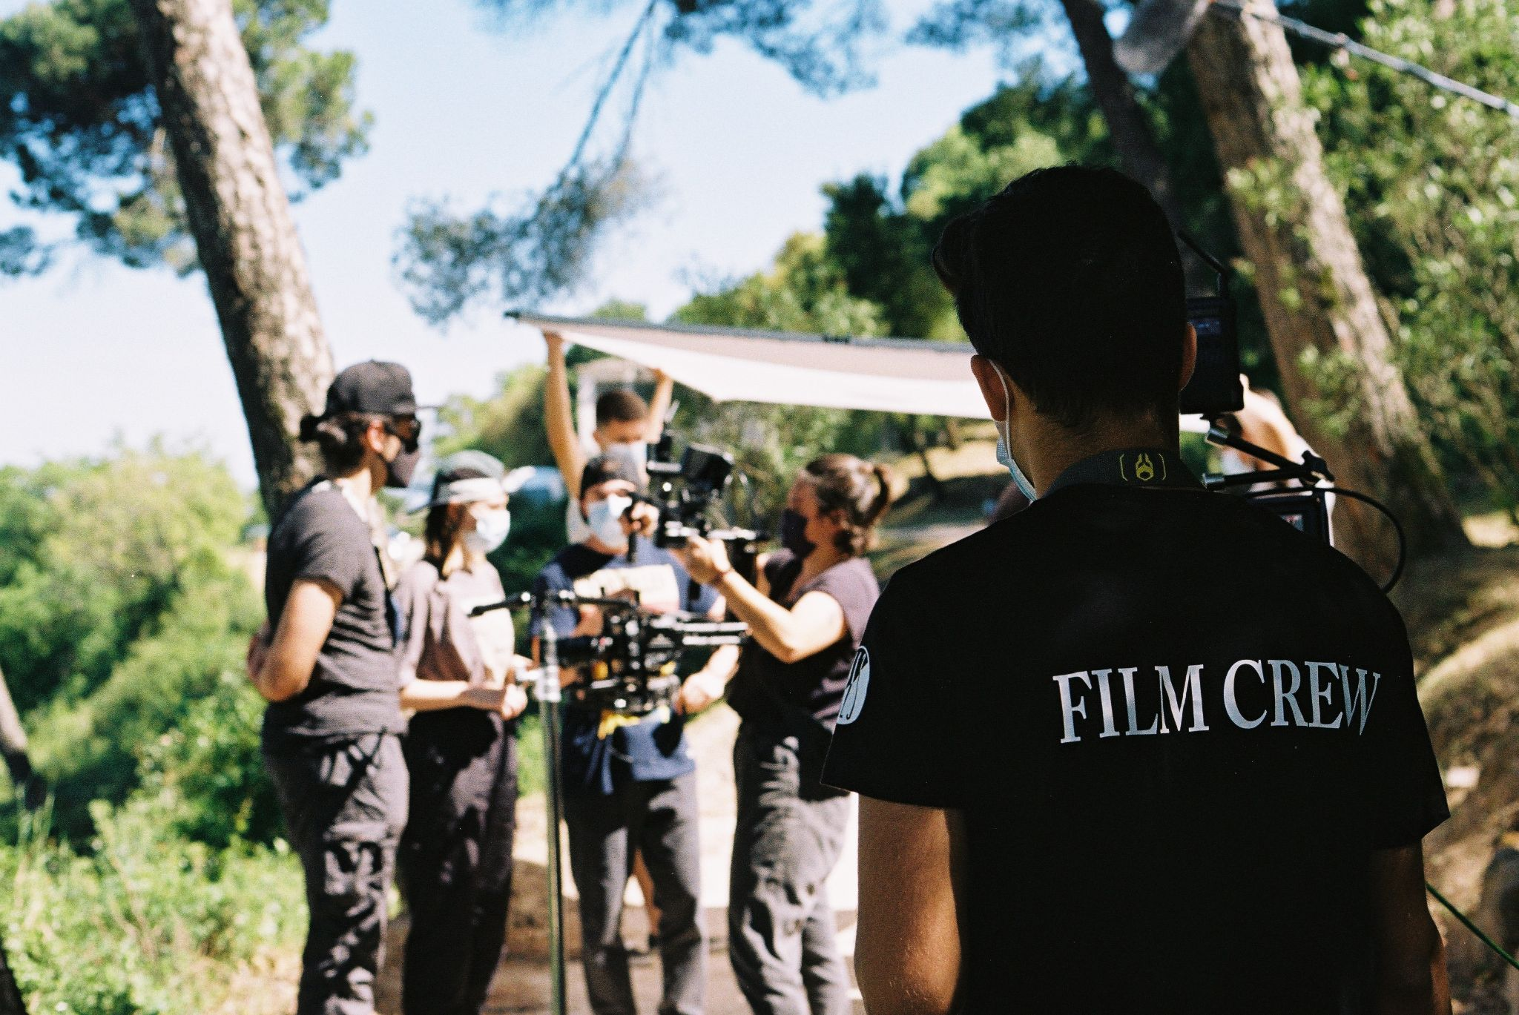
Pilot 1 2021-22
Topic
Define, investigate, and address a societal challenge concerning Sexuality, Gender and Censorship by developing a short-form series and producing a pilot episode together.

Slide 7
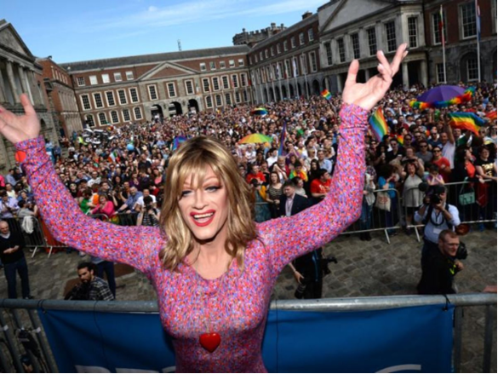
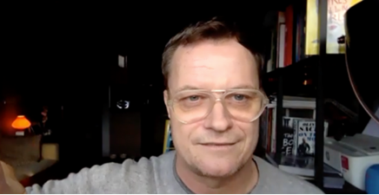
Q&A attended by teachers and students on 2021-11-26
With Rory O´Neill - Panty Bliss - (pictured) and Conor Horgan, protagonist and director from
The Queen of Ireland. Students and teachers discussed both the film and LGBTQ+ civil rights.
Still from The Queen of Ireland, directed by Conor Horgon (2015).
Students and teachers viewed the film.
Ref. 101004047, EPP-EUR-UNIV-2020 | Ref: 101035820, H2020-IBA-SwafS-Support-2-2020

Slide 8
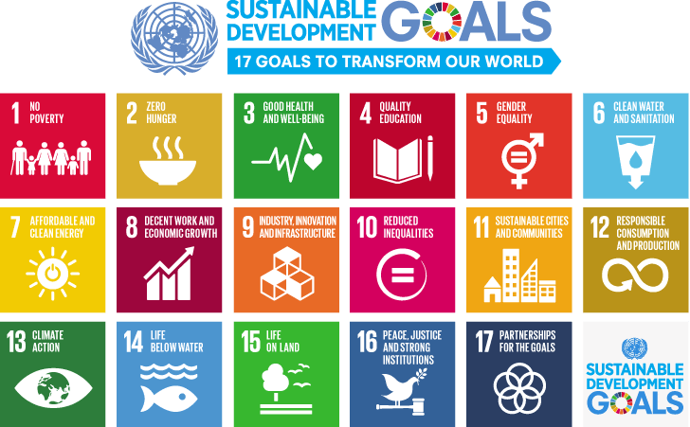
Challenge: Pilot – Year 2
Deliverable 1 – Research Deliverable 2 - Film
Pilot Year 2 BA TV and BA New Media Students – along with EU Partners
Based on an IADT Brief – Film As Art and the Challenge – Environment and Sustainability
Ref. 101004047, EPP-EUR-UNIV-2020 | Ref: 101035820, H2020-IBA-SwafS-Support-2-2020
Notes:
To empower students in the understanding of film and media history.
To give students comprehensive tools to discern and discuss the ethics of gender, sexual representation, classification and censorship at an international level.
The establishment of solid competences in digital film, providing students with key skills for contemporary film and media filmmaking.
To train students to work in a team-based environment.
Objectives:
The expansion and application of an interdisciplinary training program focusing on transmedia, providing students with the right theoretical and technical skills to succeed as transmedia creators.
To promote a comprehensive mapping of contemporary media outlets.
Students will learn how to discover and research differences and similarities between people with different cultural backgrounds, becoming proficient in understanding international projects.
Any group which, at the start, includes individuals with different levels theoretical and technical know-how should, at the end, express a more balanced level of proficiency.
The blossoming of co-production enterprises between all institutions involved in the FilmEU Alliance.
To create a solid platform for discussion and consolidation on the topic of citizenship and democracy when applied to an author’s social impact.

Slide 9
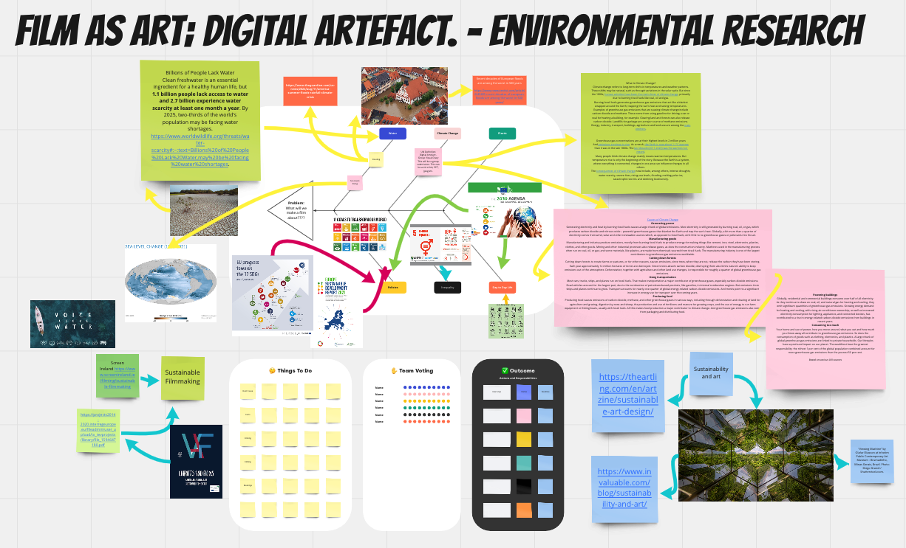
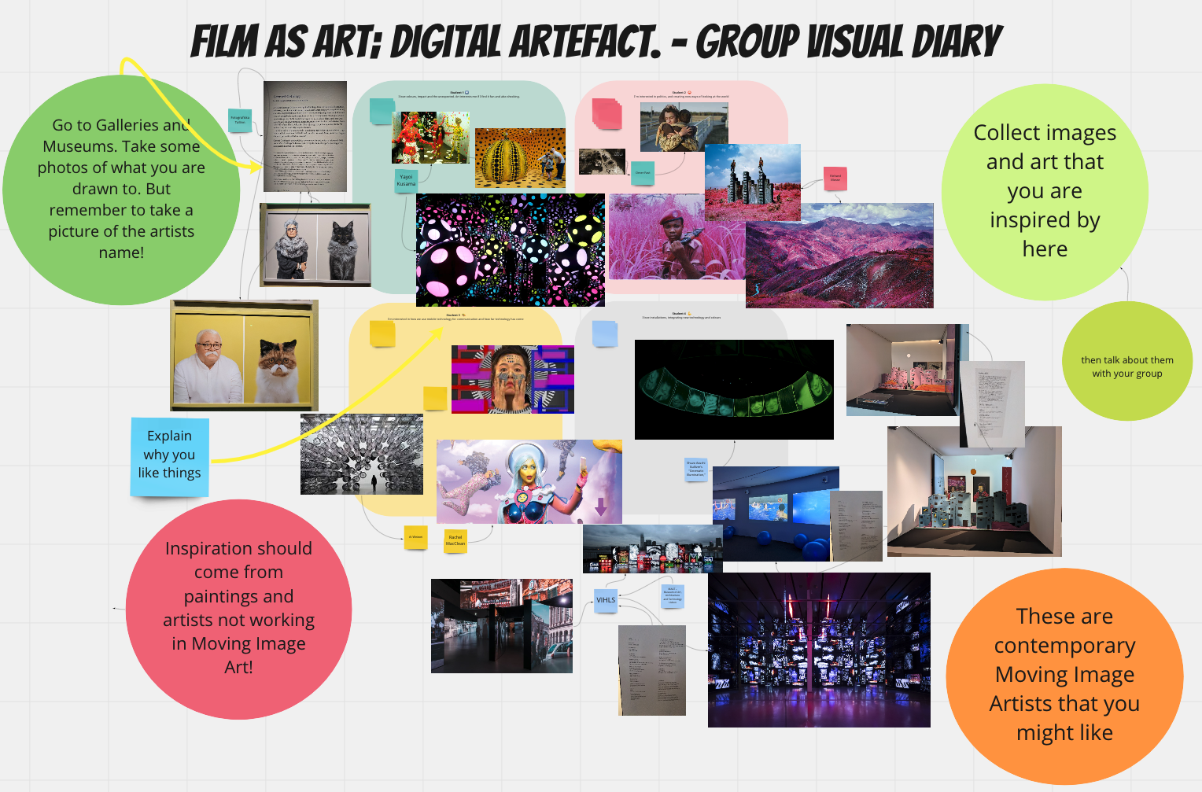
Deliverable 1 – Two
Research Digital Artifacts
– challenge and art
Deliverable 2 - Film
Ref. 101004047, EPP-EUR-UNIV-2020 | Ref: 101035820, H2020-IBA-SwafS-Support-2-2020
Notes:
To empower students in the understanding of film and media history.
To give students comprehensive tools to discern and discuss the ethics of gender, sexual representation, classification and censorship at an international level.
The establishment of solid competences in digital film, providing students with key skills for contemporary film and media filmmaking.
To train students to work in a team-based environment.
Objectives:
The expansion and application of an interdisciplinary training program focusing on transmedia, providing students with the right theoretical and technical skills to succeed as transmedia creators.
To promote a comprehensive mapping of contemporary media outlets.
Students will learn how to discover and research differences and similarities between people with different cultural backgrounds, becoming proficient in understanding international projects.
Any group which, at the start, includes individuals with different levels theoretical and technical know-how should, at the end, express a more balanced level of proficiency.
The blossoming of co-production enterprises between all institutions involved in the FilmEU Alliance.
To create a solid platform for discussion and consolidation on the topic of citizenship and democracy when applied to an author’s social impact.

Slide 10
Dissemination: SUMMITS CONFERENCES AND T&L!
Ref. 101004047, EPP-EUR-UNIV-2020 | Ref: 101035820, H2020-IBA-SwafS-Support-2-2020
Notes:
To empower students in the understanding of film and media history.
To give students comprehensive tools to discern and discuss the ethics of gender, sexual representation, classification and censorship at an international level.
The establishment of solid competences in digital film, providing students with key skills for contemporary film and media filmmaking.
To train students to work in a team-based environment.
Objectives:
The expansion and application of an interdisciplinary training program focusing on transmedia, providing students with the right theoretical and technical skills to succeed as transmedia creators.
To promote a comprehensive mapping of contemporary media outlets.
Students will learn how to discover and research differences and similarities between people with different cultural backgrounds, becoming proficient in understanding international projects.
Any group which, at the start, includes individuals with different levels theoretical and technical know-how should, at the end, express a more balanced level of proficiency.
The blossoming of co-production enterprises between all institutions involved in the FilmEU Alliance.
To create a solid platform for discussion and consolidation on the topic of citizenship and democracy when applied to an author’s social impact.

Slide 11
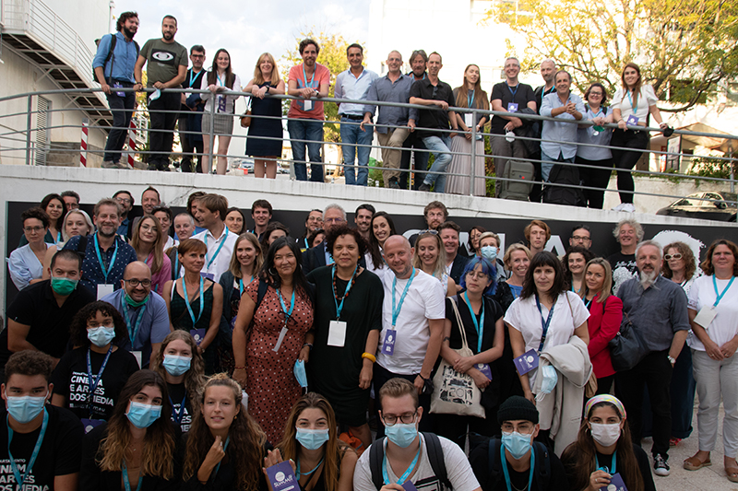
INTEGRATING INTO OUR CLASSROOM
As well as integrating into our teaching practice we
Samsara handbook developed
Promotional video produced
Presented at Conferences and the FilmEU Summits
And are here speaking to you wonderful people!
Ref. 101004047, EPP-EUR-UNIV-2020 | Ref: 101035820, H2020-IBA-SwafS-Support-2-2020

Slide 12

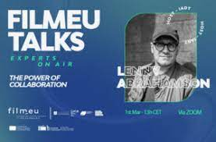

Collaborating with Industry Experts
Experts on Air is a continuing monthly talks from industry experts – linking us with key stakeholders and changes within the industry – open to all!
Ref. 101004047, EPP-EUR-UNIV-2020 | Ref: 101035820, H2020-IBA-SwafS-Support-2-2020

Slide 13
Dissemination:
STAFF CAPACITATION- PEDAGOGICAL SKILLS Mooc
Ref. 101004047, EPP-EUR-UNIV-2020 | Ref: 101035820, H2020-IBA-SwafS-Support-2-2020
Notes:
To empower students in the understanding of film and media history.
To give students comprehensive tools to discern and discuss the ethics of gender, sexual representation, classification and censorship at an international level.
The establishment of solid competences in digital film, providing students with key skills for contemporary film and media filmmaking.
To train students to work in a team-based environment.
Objectives:
The expansion and application of an interdisciplinary training program focusing on transmedia, providing students with the right theoretical and technical skills to succeed as transmedia creators.
To promote a comprehensive mapping of contemporary media outlets.
Students will learn how to discover and research differences and similarities between people with different cultural backgrounds, becoming proficient in understanding international projects.
Any group which, at the start, includes individuals with different levels theoretical and technical know-how should, at the end, express a more balanced level of proficiency.
The blossoming of co-production enterprises between all institutions involved in the FilmEU Alliance.
To create a solid platform for discussion and consolidation on the topic of citizenship and democracy when applied to an author’s social impact.

Slide 14

DESIGNING MOOC
PROCESS OF DESIGNING MOOCS
WRITING
REVIEWING
FINDING SPEAKERS
FILMING
EDITING
DISTRIBUTION ON LINE – Lusofana X
Ref. 101004047, EPP-EUR-UNIV-2020 | Ref: 101035820, H2020-IBA-SwafS-Support-2-2020

Slide 15
Thanks
Questions?
Ref. 101004047, EPP-EUR-UNIV-2020 | Ref: 101035820, H2020-IBA-SwafS-Support-2-2020
Notes:
To empower students in the understanding of film and media history.
To give students comprehensive tools to discern and discuss the ethics of gender, sexual representation, classification and censorship at an international level.
The establishment of solid competences in digital film, providing students with key skills for contemporary film and media filmmaking.
To train students to work in a team-based environment.
Objectives:
The expansion and application of an interdisciplinary training program focusing on transmedia, providing students with the right theoretical and technical skills to succeed as transmedia creators.
To promote a comprehensive mapping of contemporary media outlets.
Students will learn how to discover and research differences and similarities between people with different cultural backgrounds, becoming proficient in understanding international projects.
Any group which, at the start, includes individuals with different levels theoretical and technical know-how should, at the end, express a more balanced level of proficiency.
The blossoming of co-production enterprises between all institutions involved in the FilmEU Alliance.
To create a solid platform for discussion and consolidation on the topic of citizenship and democracy when applied to an author’s social impact.

